Slide 1
How to Train a Cat to Do “Double Paw”
Starlan Davis
Technical Writing
Kennesaw State University
June 27, 2025

Slide 2

Step 1. Obtain Desirable Treats
The most important part of training a cat is to have a reward available. For most cats, treats are the most effective reward, though some may have a favorite toy that you can use. But if you are using treats, ensure that your cat enjoys them as each cat has unique tastebuds and, therefore, unique preferences.
Figure 1
Image of a bag of cat supplements to be used as training treats/rewards. Created by the author.

Slide 3
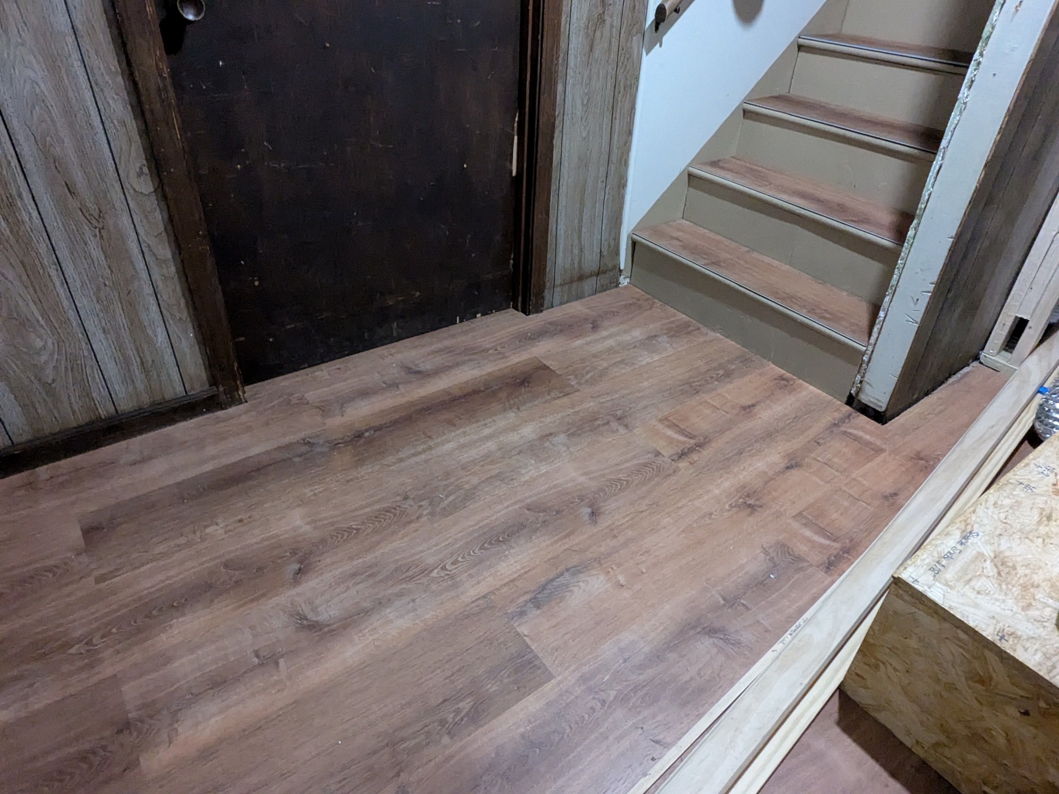
Step 2. Find a Space with Minimal Distractions
At the start of training your cat a new trick or command, it is beneficial to work with them in a space where they are comfortable and there are few distractions. This is to encourage your cat to pay more attention to you and stay focused during the training session.
Figure 2
Image of an empty space to be used as the training location. Created by the author.

Slide 4
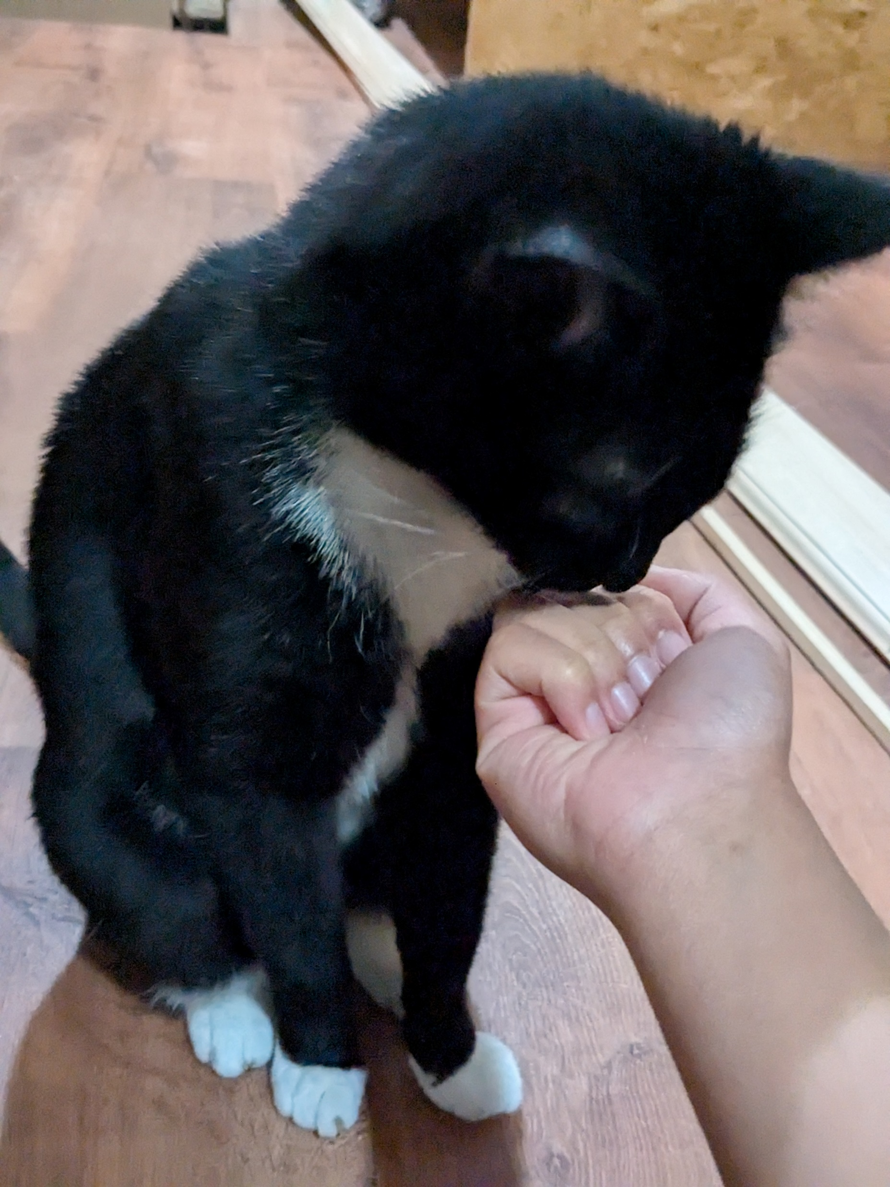
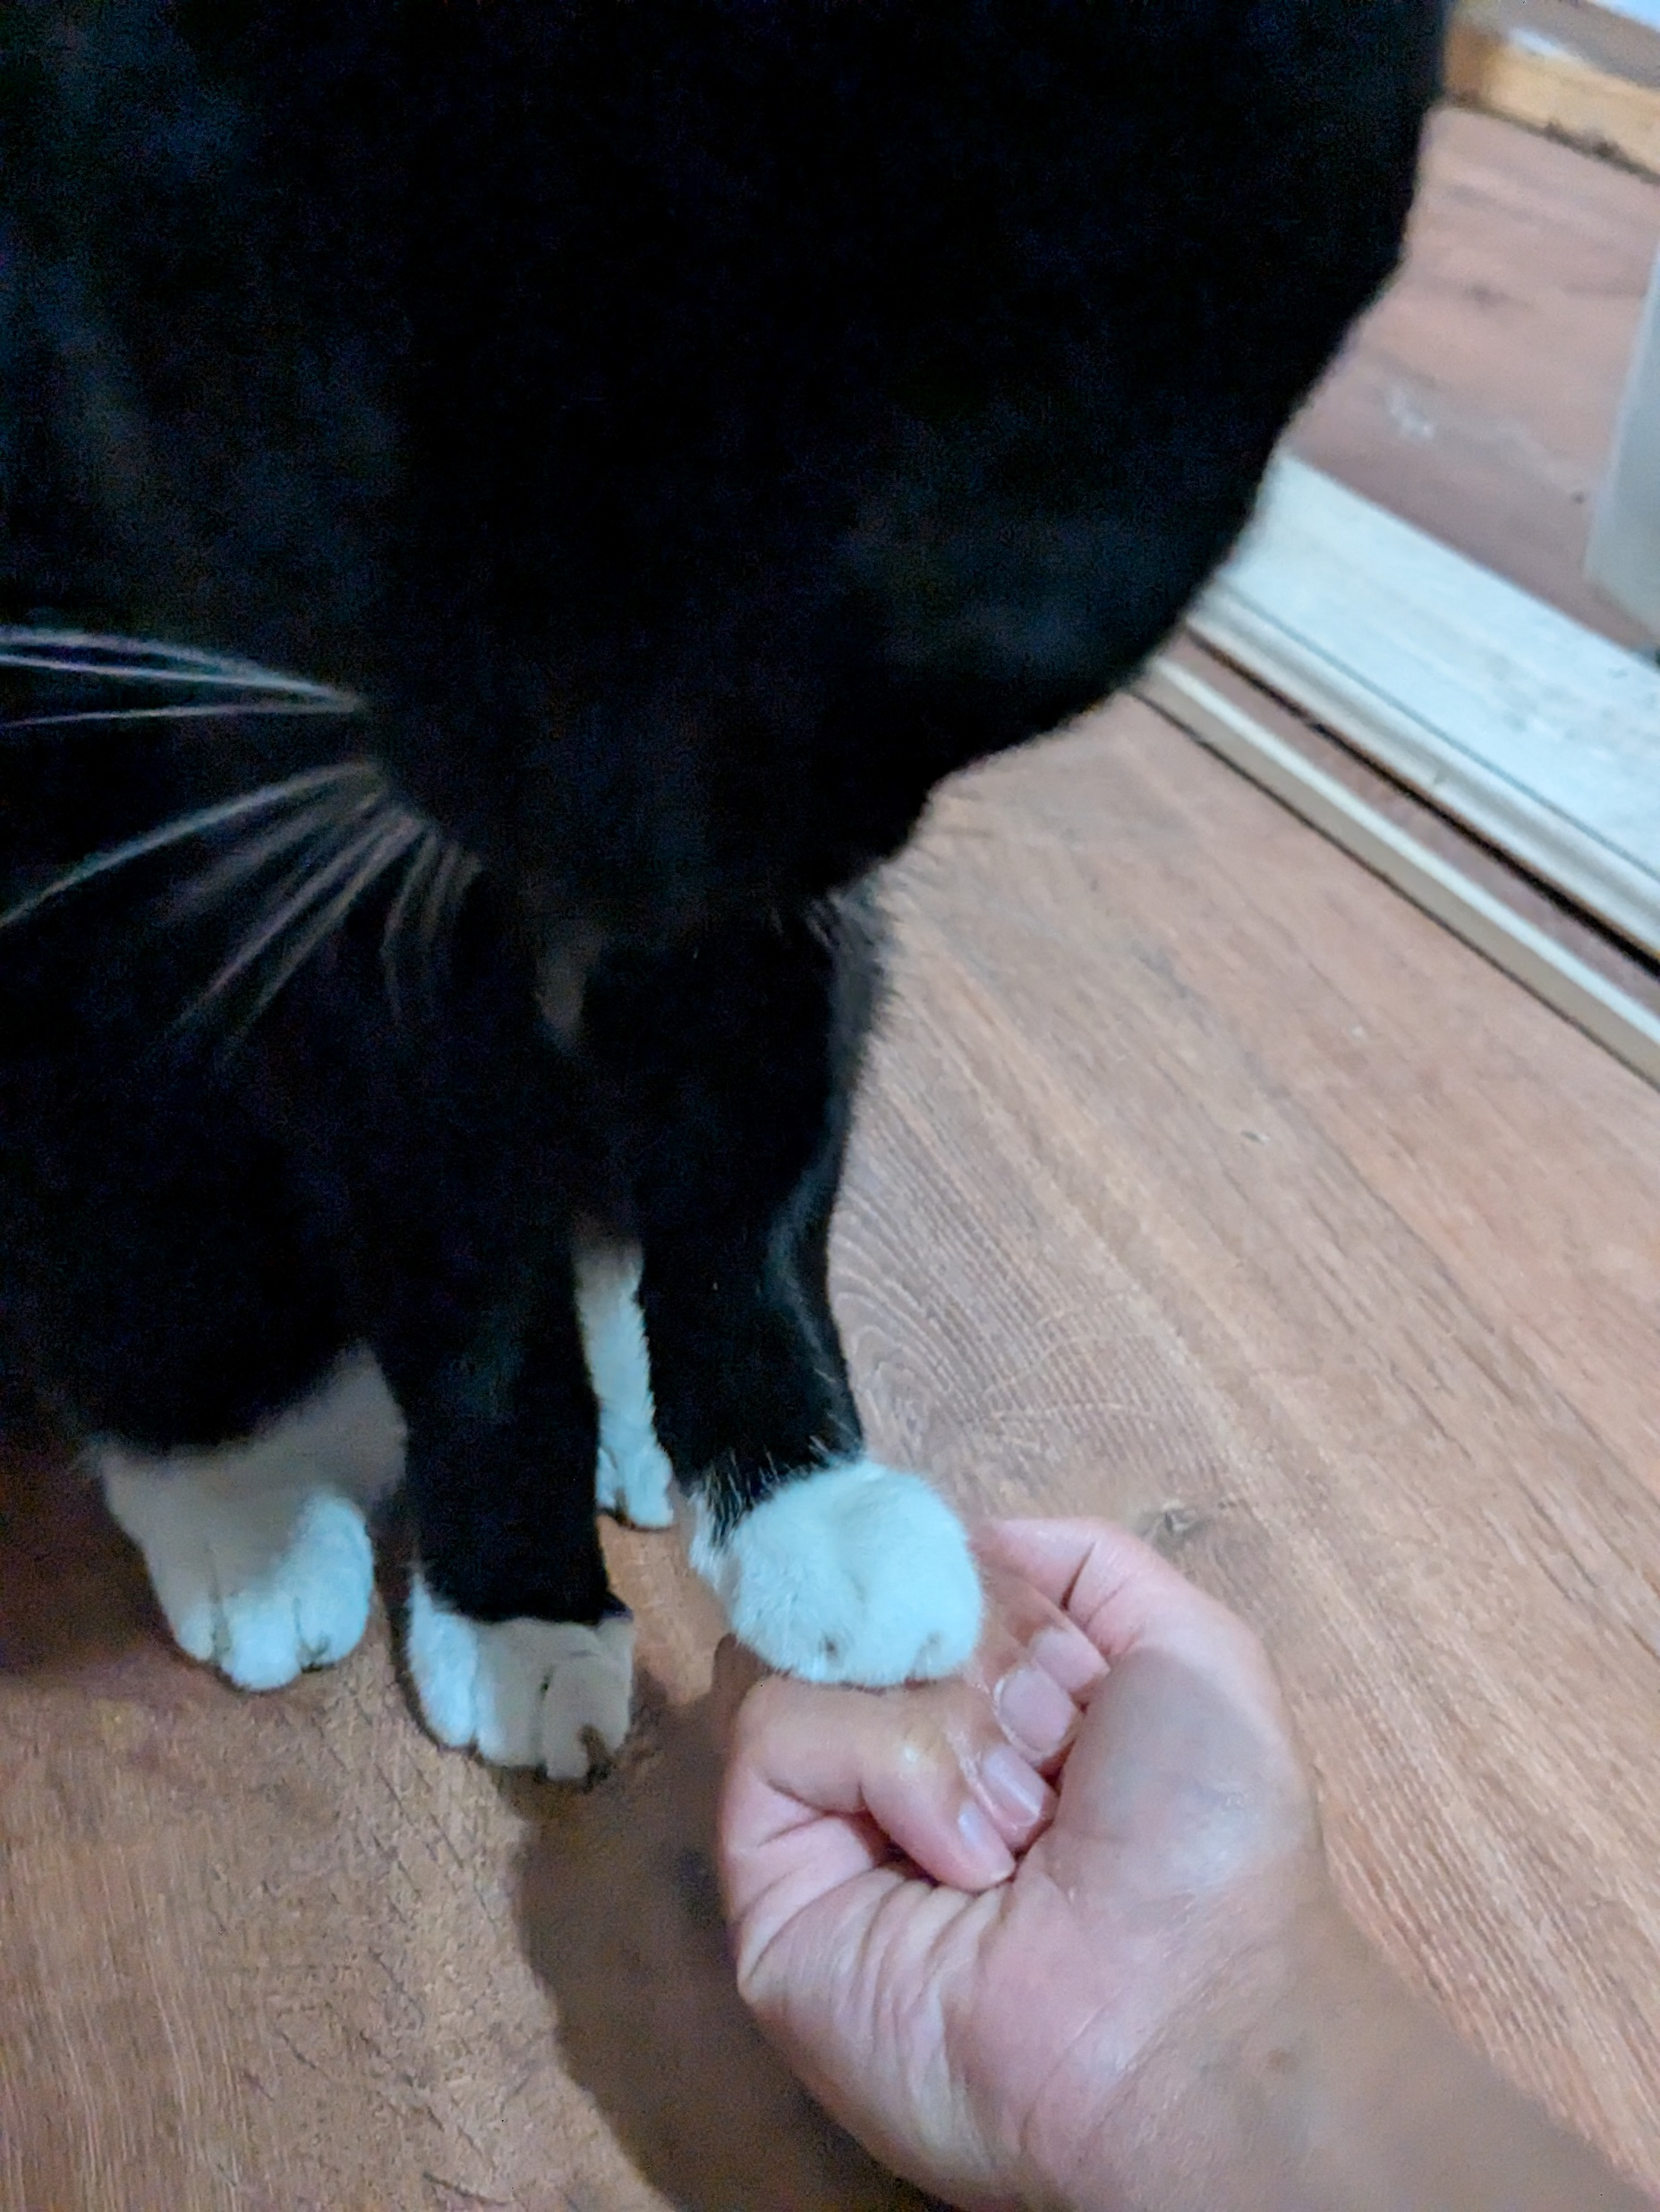
Step 3. Teach “Paw” – Hold Out Your Fist with a Treat in it
Start by holding a treat in your hand, make a loose fist, and hold it out to the cat. Wait until the cat touches your hand with its paw, then open your hand and offer the treat. Patience is key throughout this process. Just wait patiently without nudging or saying commands or phrase. Repeat this step several times until the cat begins to put their paw out as soon as you place your hand in front of them.
Figure 3
Image of author’s cat smelling the treat through the author’s closed hand. Created by the author.
Figure 4
Image of author’s cat placing his paw on the author’s closed hand. Created by the author.

Slide 5
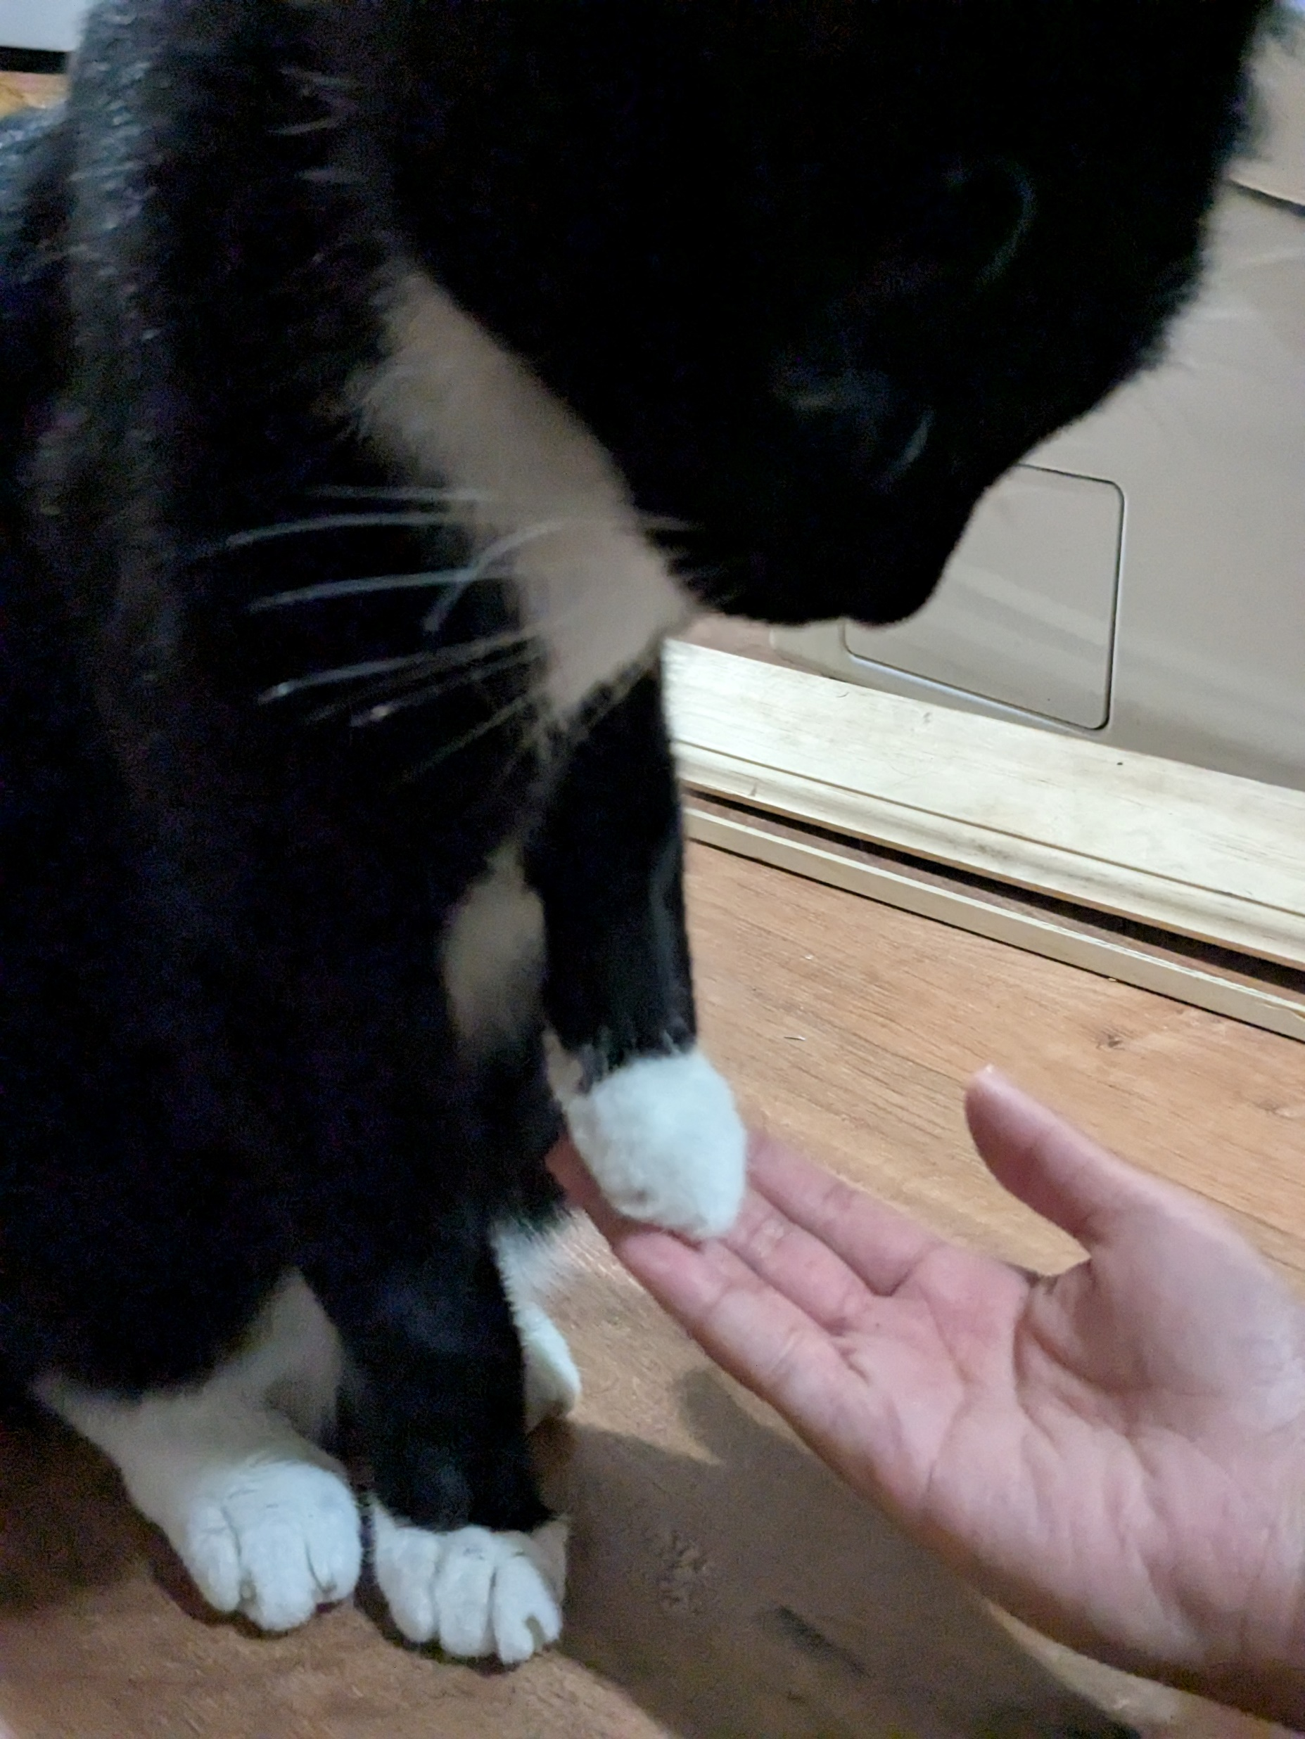
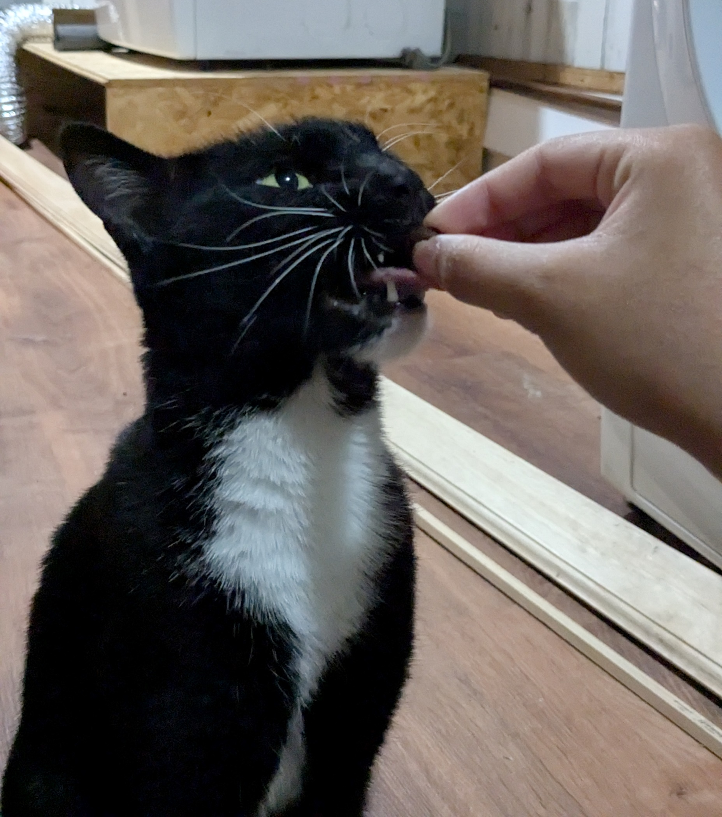
Step 4. Teach “Paw,” – Open Your Palm
Once your cat has become consistent with step 3, place your empty palm out in front of your cat. Wait to give them the treat (from your other hand) until they have placed their paw onto your open hand.
Figure 6
Image of author’s cat placing his paw on the author’s open hand. Created by the author.
Figure 5
Image of author’s cat being given a treat after performing Step 3. Created by the author.

Slide 6
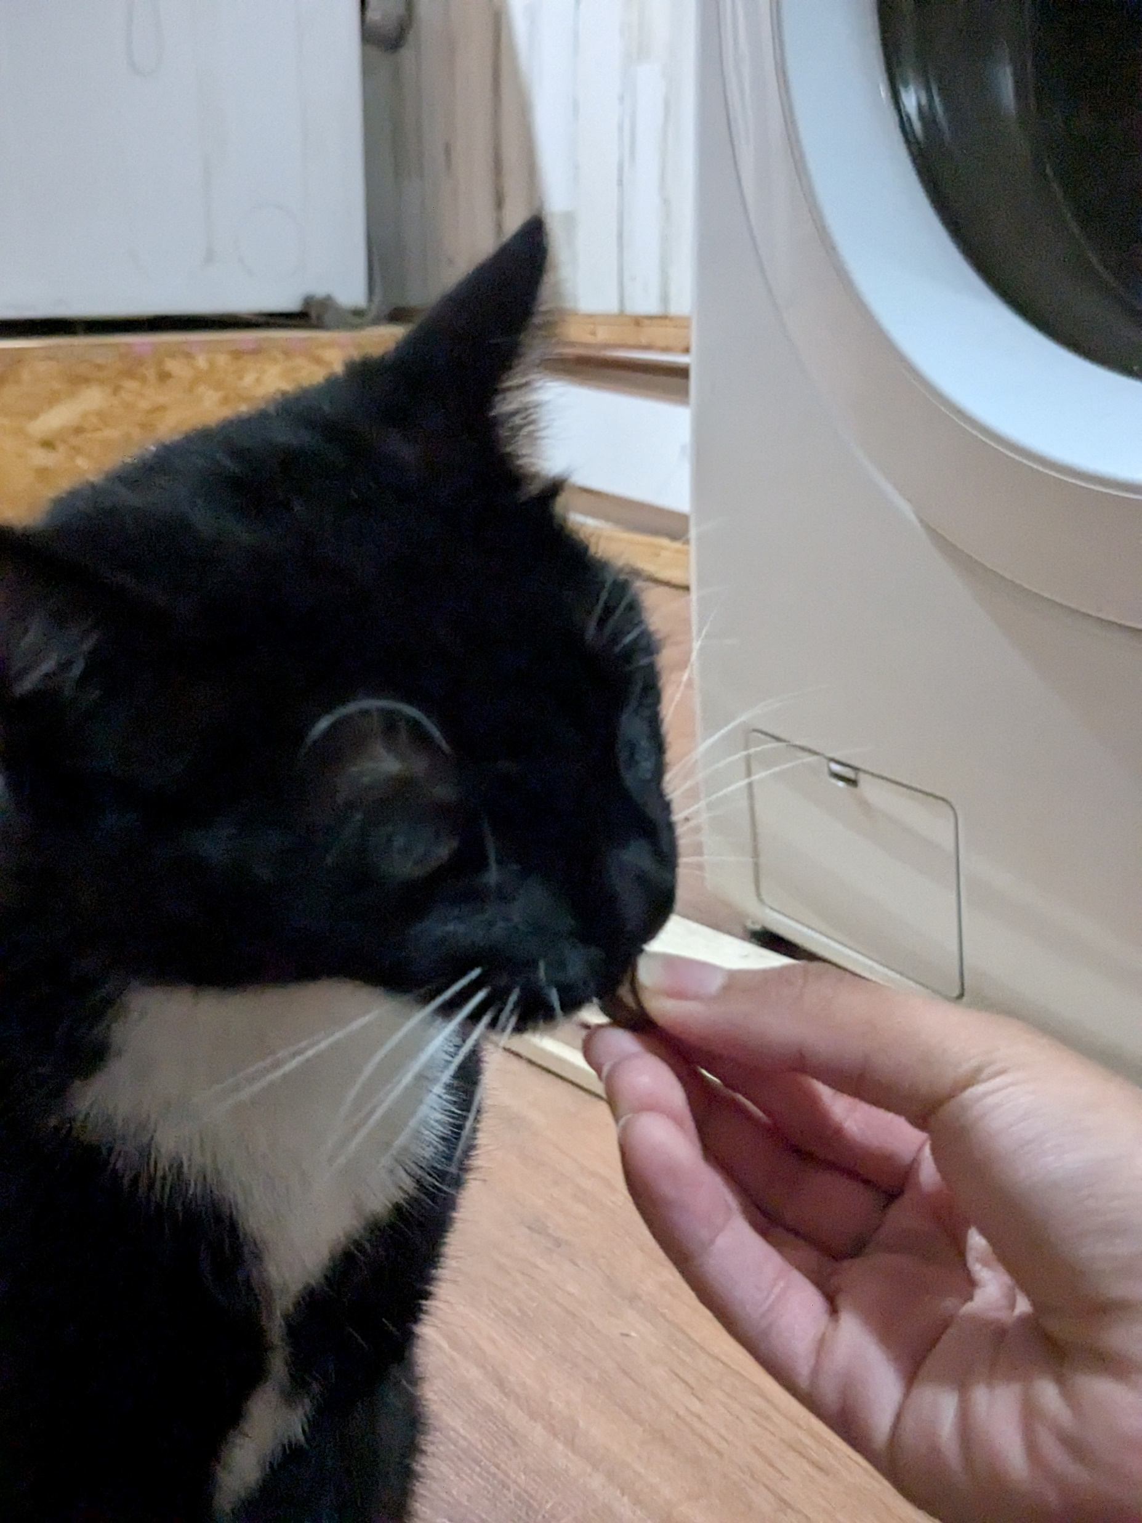
Step 5. Introduce a Verbal Cue
Introduce a verbal command by saying your chosen word once before holding out your hand. Remember to be patient. Do not nudge the cat, repeat the command, or start saying other words or phrases.
Figure 7
Image of author’s cat being given a treat. Created by the author.

Slide 7
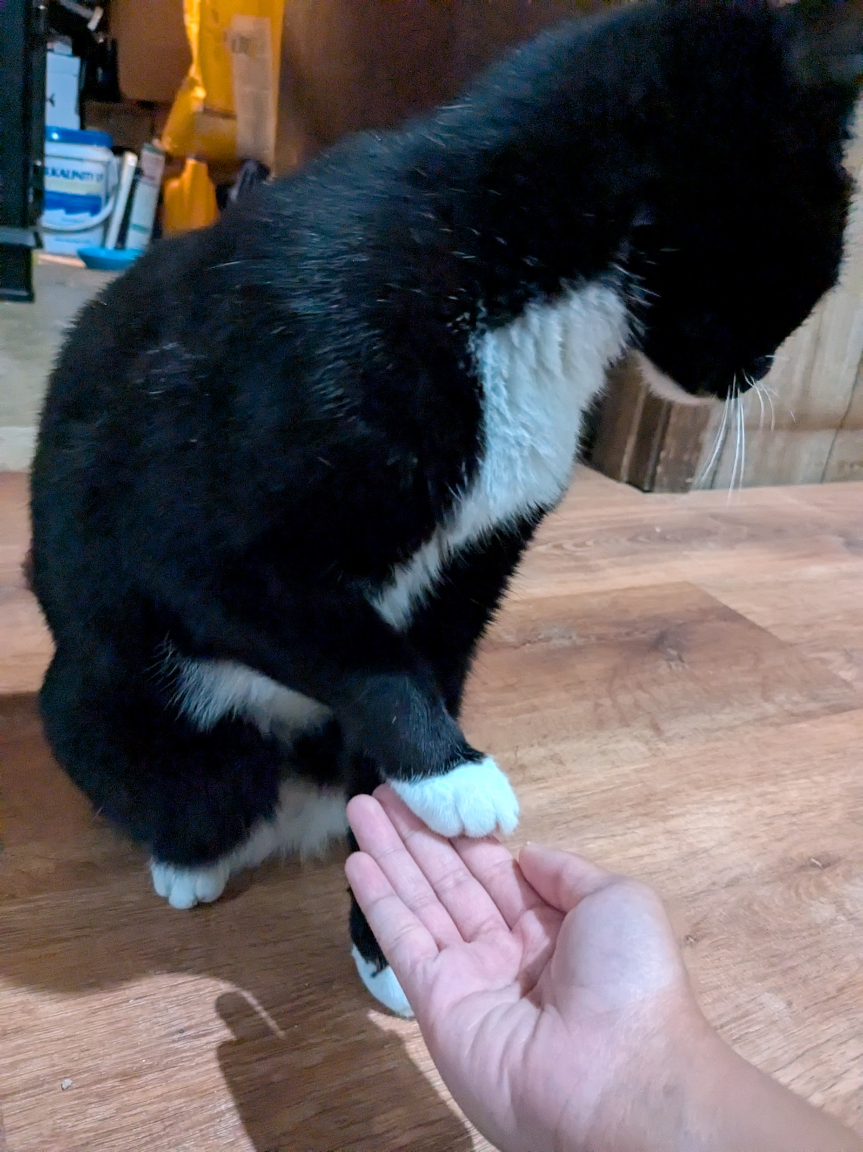
Step 6. Teach “Paw” with the Alternate Side
Repeat steps 3 and 4, but this time with your other hand and the cat’s other paw. Your cat will likely start off using the same paw as before, but do not give them the treat until they use their other paw.
Figure 8
Image of author’s cat placing his alternate paw on the author’s open hand. Created by the author.

Slide 8
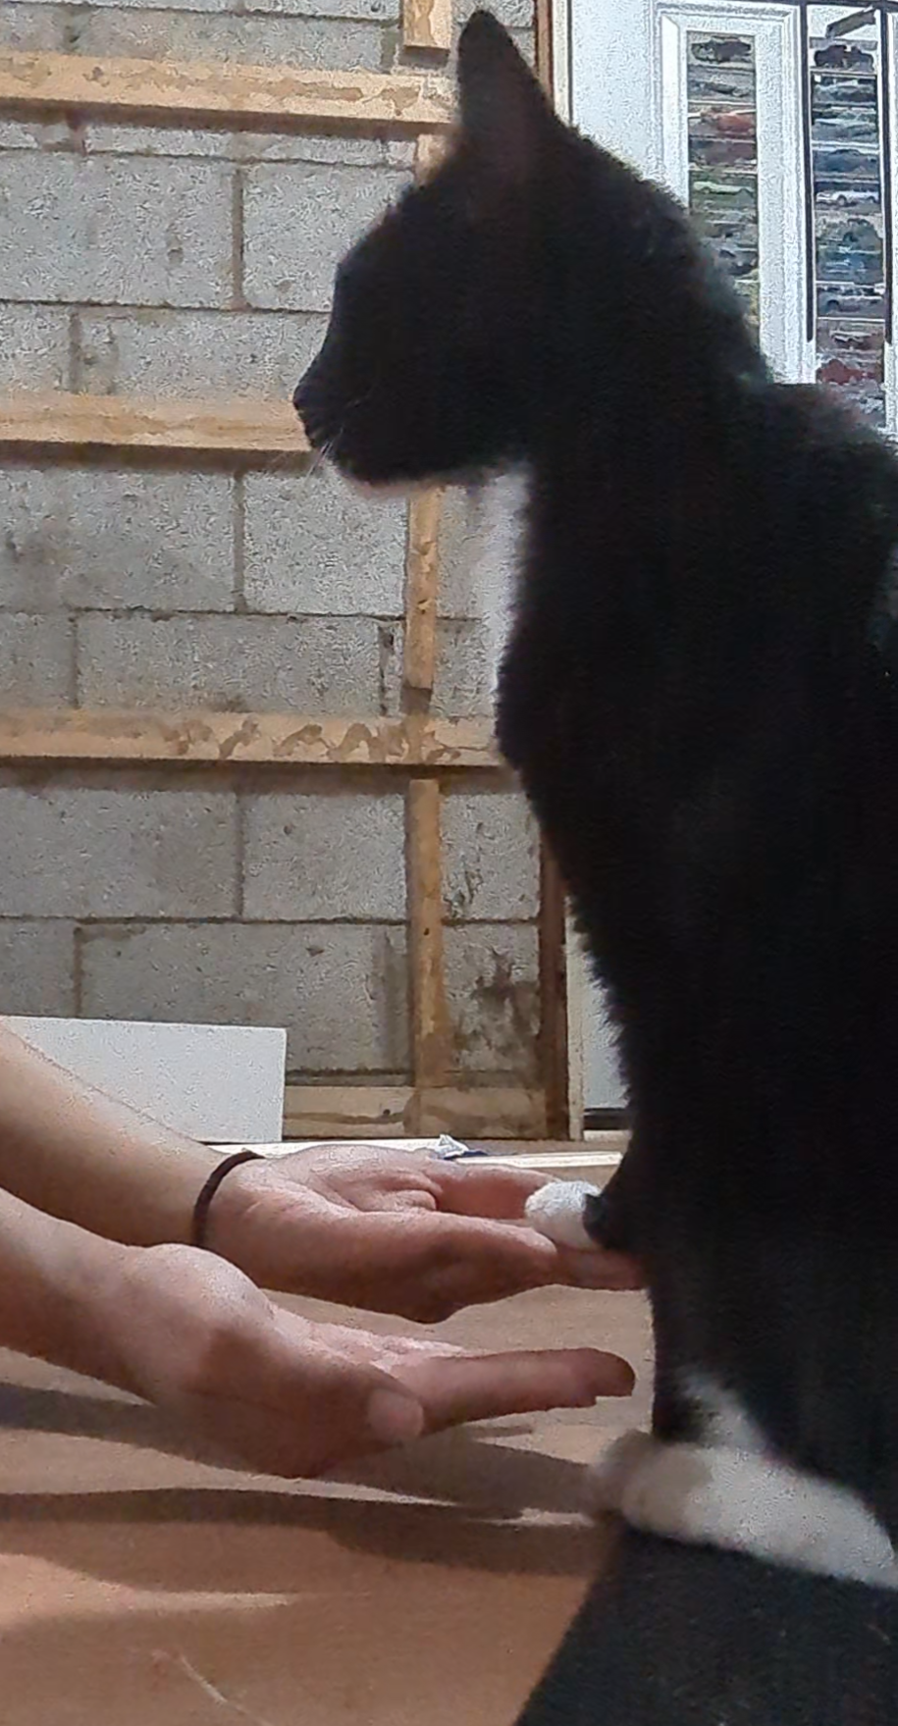
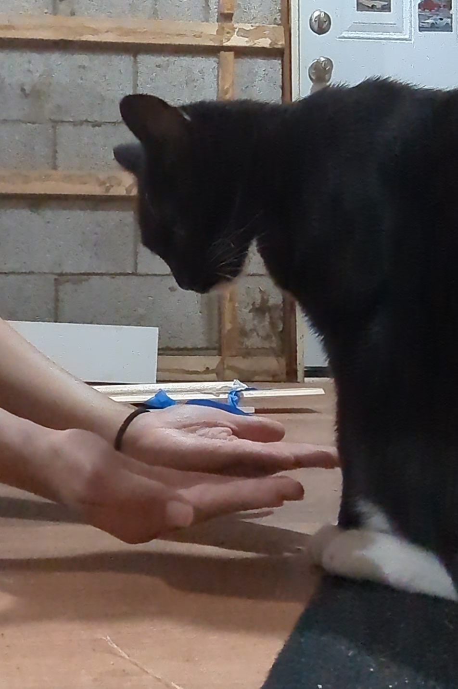
Step 7. Starting “Double Paw”
Repeat step 4, but this time using both of your hands at once. Hold out both of your empty palms in front of your cat and wait until he or she places both paws onto your hands simultaneously.
Figure 10
Image of author’s cat testing the new requirement by placing one paw onto the author’s hand. Created by the author.
Figure 9
Image of introducing both hands, simultaneously, to the cat. Created by the author.

Slide 9
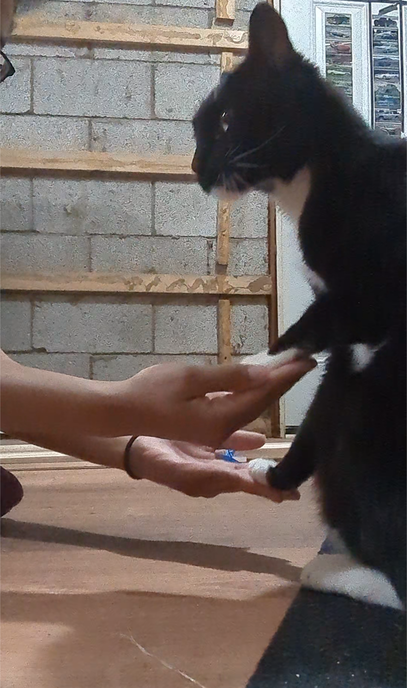
Step 8. Introducing a Verbal Cue
You can use the same command as before or a new word, such as “both” or “two.”
Figure 11
Image of author’s cat placing both paws onto the author’s hands. Created by the author.

